Slide 1
Operational Amplifier: Introduction

Slide 2
Outline
Dependent Sources
Operational Amplifier: Introduction
Op-Amp: Circuit Symbols and terminal
Op-Amp: VTC (Voltage Transfer Characteristics)
Linear Amplification
(Positive and Negative) Saturation
Op-Amp: Examples
Op-Amp: Physical Entity

Slide 3
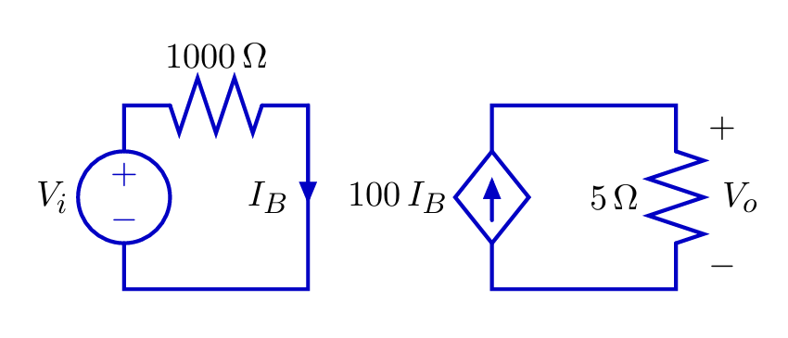
Dependent Sources
To analyze op-amps, we must understand dependent source.
A dependent source generates a voltage or current whose value depends on another voltage or current.
Example: current-controlled current source

Slide 4
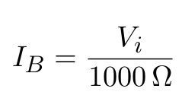
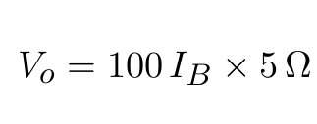
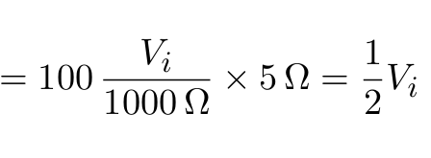
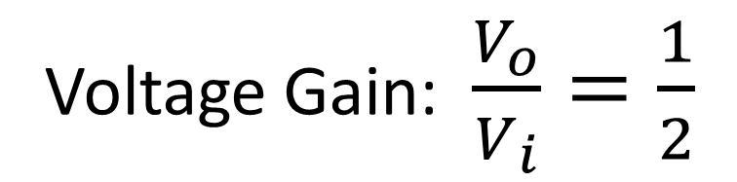
Dependent Sources

Slide 5
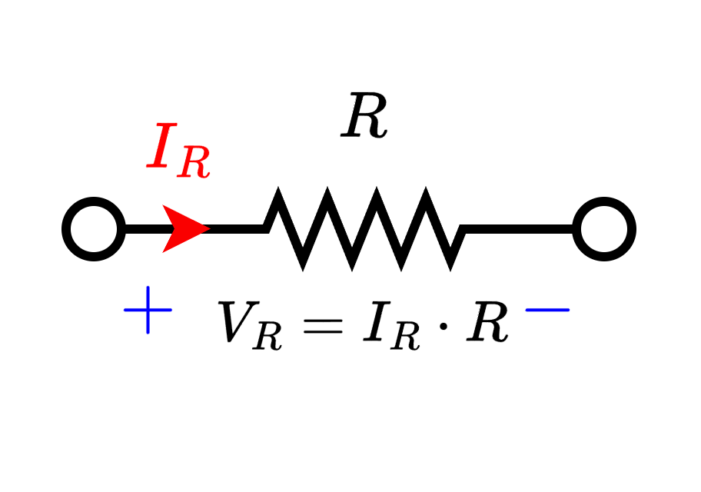
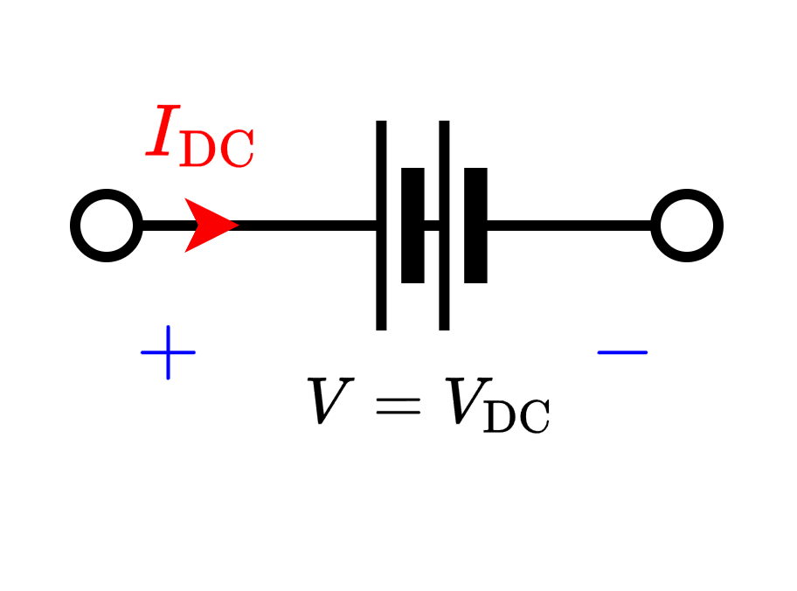
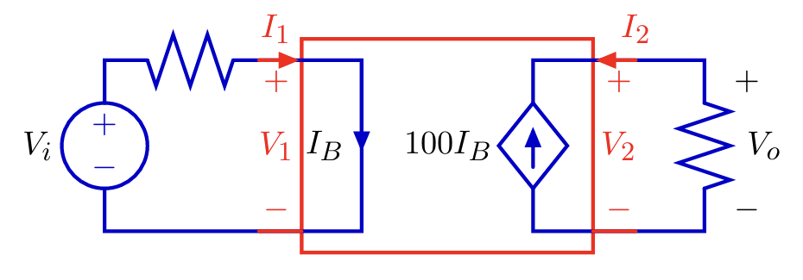
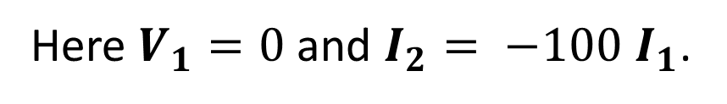
Dependent Sources
Resistors, (Ind.) Voltage sources, (Ind.) Current sources are single “port” device. They are characterized by a single equation.
Dependent sources are two-ports: characterized by two equations.

Slide 6
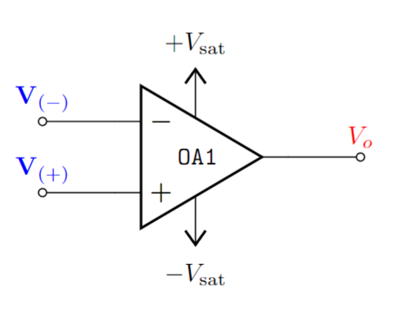
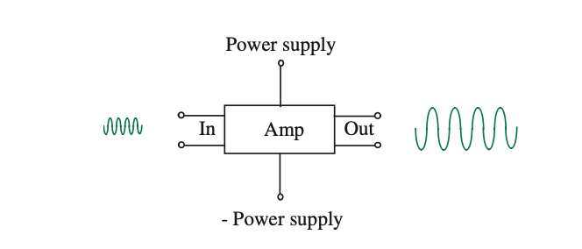
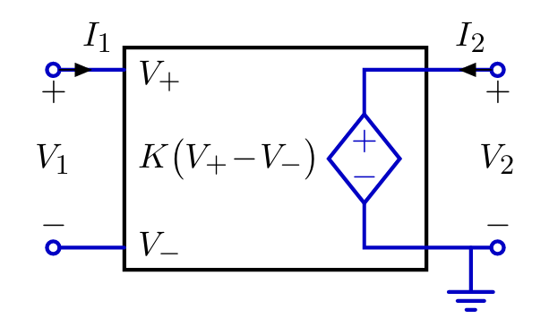


Operational Amplifier: Introduction
Operational:
Mathematical Operations
Amplifier:
Amplifies input signal/voltage.
Large Signal
Small Signal
An op-amp (operational amplifier) can be modelled by a voltage- controlled voltage source.
Small Signal
Large Signal

Slide 7


Operational Amplifier: Introduction
An op-amp (operational amplifier) can be represented by a voltage- controlled voltage source.
Small Signal
Large Signal

Slide 8
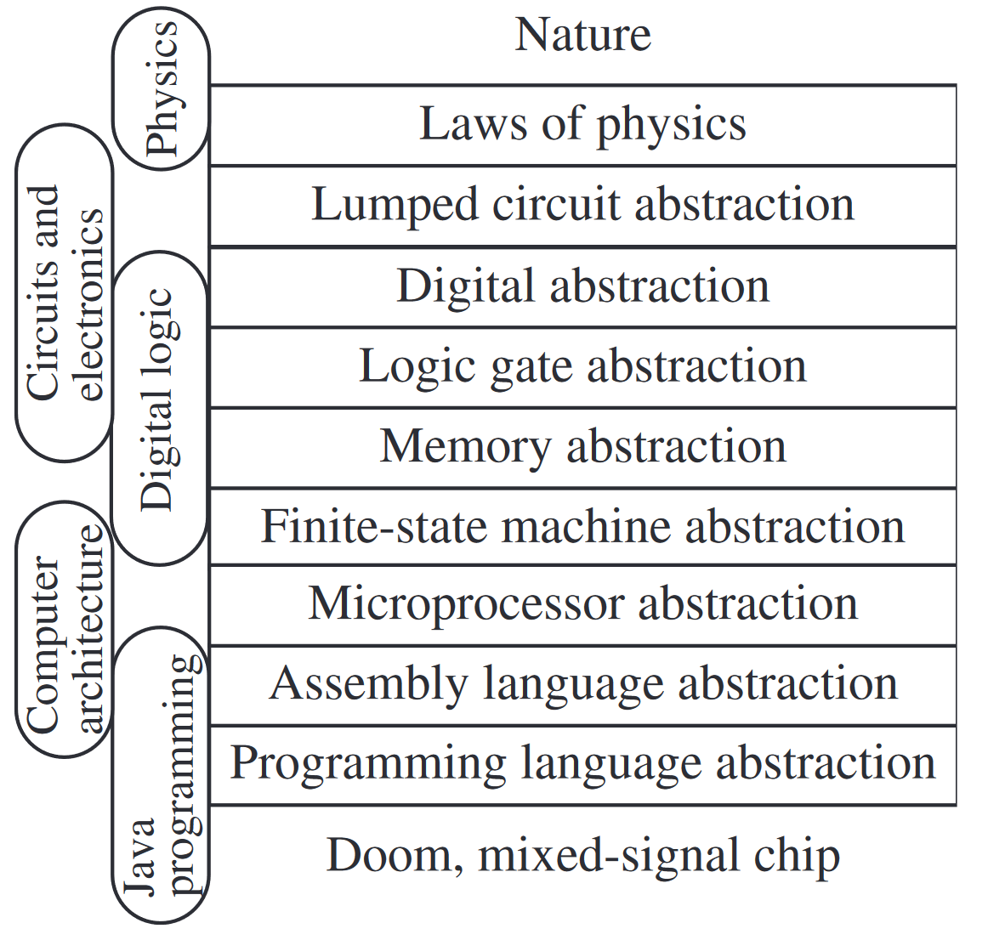
Operational Amplifier: Introduction
The Circuit Abstraction
Op-Amp
Sequence of courses and the abstraction layers

Slide 9
Op-Amp: Circuit Symbols and terminal
Positive Saturation / Supply Voltage
Inverting terminal voltage
Output Voltage
Non-inverting terminal voltage
Negative Saturation / Supply Voltage

Slide 10



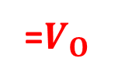

Op-Amp: Circuit Symbols and terminal
Difference Amplifier –
Amplifies the voltage difference between two terminals.
 | Differential input voltage
Voltage Transfer Characteristics (VTC)

Slide 11
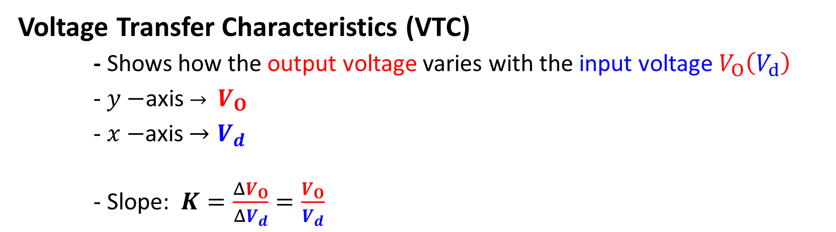





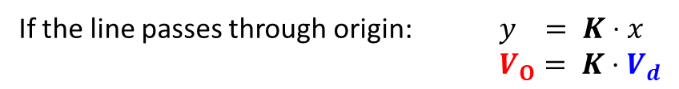
Op-Amp: VTC – Linear Amplification
15 V
1.5 V
LINEAR AMPLIFICATION

Slide 12
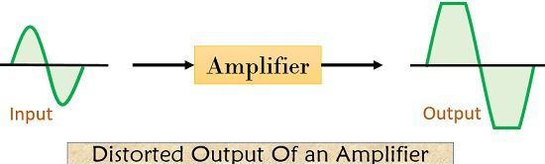
Op-Amp: VTC – Linear Amplification
Linear Amplification only takes place within a valid input range.
Otherwise output will be distorted - - Saturation
The limiting factor of linear amplification is determined by the power supply to the amplifier

Slide 13

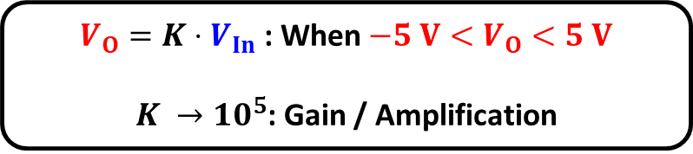


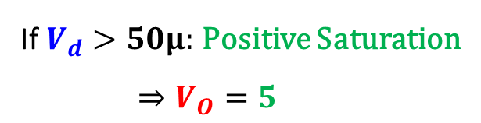

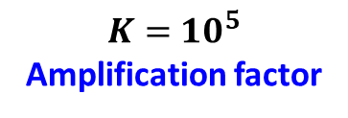



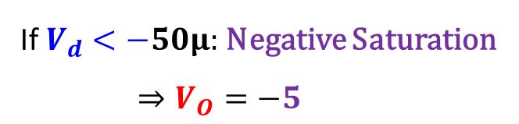

Op-Amp: VTC - Saturation
Non-Linear characteristics

Slide 14


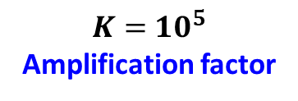
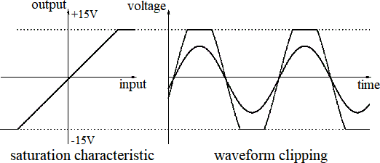




Op-Amp: VTC - Saturation

Slide 15

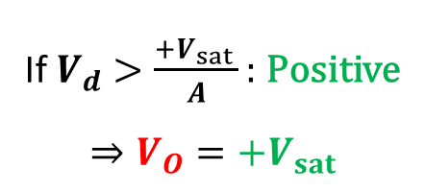


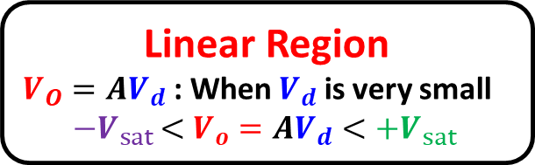




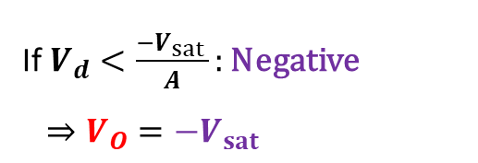

Op-Amp: VTC - Summary
Voltage Transfer Characteristics (VTC)
Positive saturation:
Output
axis
Negative saturation:
Input
axis

Slide 16

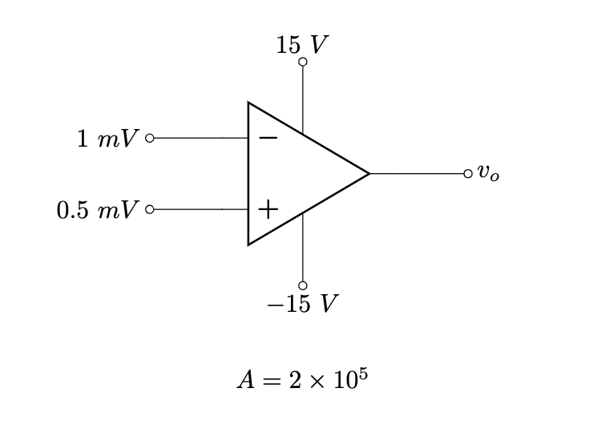
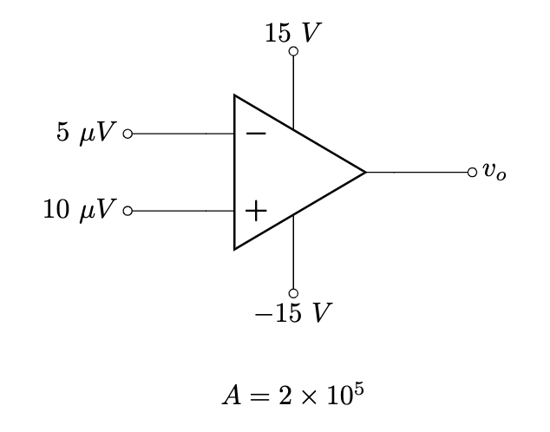
Op-Amp: Examples

Slide 17












Example 1
Solution:

Slide 18










Example 2
Solution:
(Negative saturation)

Slide 19
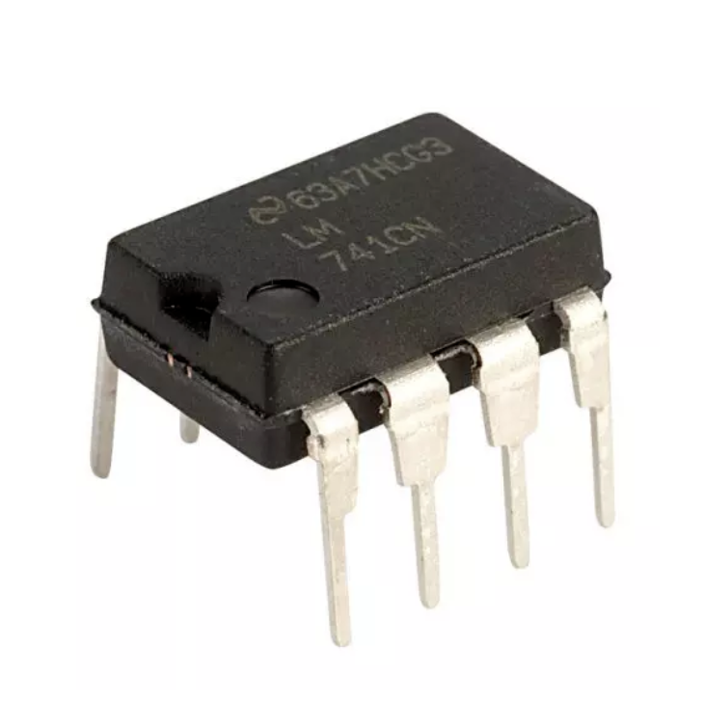
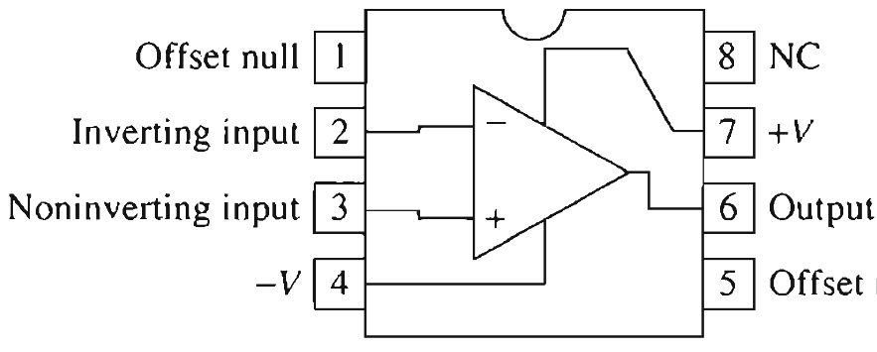
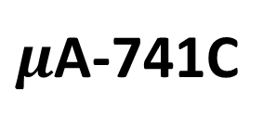
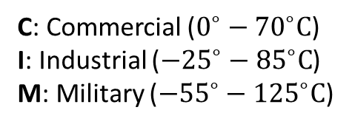
Op-Amp: Physical Entity
Difference Amplifier – Amplifies the voltage difference between two terminals.
7
NC – No Connection
2
6
3
4
Circuit symbol for the general-purpose op amp.
Pin numbering is that for an 8-pin mini-DIP package
Manufacturer ID
Part Identification Number (PIN)

Slide 20

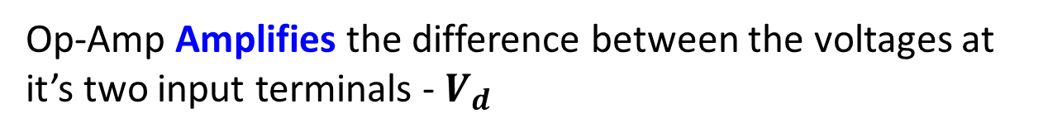
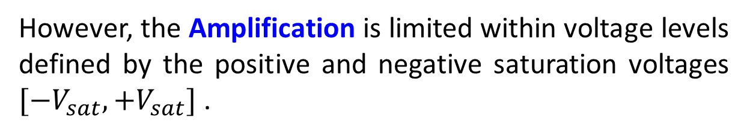




Op-Amp: Summary
The “ideal” op-amp behaves like a voltage dependent voltage source within the linear region.

Slide 21
Thank you!

